Slide 1
Responding to RFPs
Tips to increase
probability of winning
REIBC & AIC-BC Conference
September 27, 2013

Slide 2
Agenda
  What is an RFP?
  What is the process for submitting bids?
  What does a successful proposal look like?
  Q&A

Slide 3
What is an RFP?
A tool to create a competitive environment for the procurement of goods and services
  Used by both Private & Public Sector
  Enables the buyer to get the best possible product at the best possible price from the most qualified suppliers.
  RFP can also provide for safeguards against fraud, collusion, nepotism, and cronyism.

Slide 4
The Evolution of the RFP
Historically only used in the public sector
Virtually every sector of business both private and public now use the RFP to:
  Create a competitive situation
  Encourage “Out Of The Box” thinking
  Range of potential solutions/prices

Slide 5
Types of Requests – 3 types
Data gathering - may or may not contract
  Request for Expressions of Interest (RFEI)
  Request for Information (RFI)
  Request for Qualifications (RFQL)
  Request for Technical Specifications (RFTS)
  Approved Vendor List

Slide 6
Types of Requests – 3 types
Will probably contract, but no vendor selected
  Request for Quotation (RFQT)
  Request for Proposal (RFP)

Slide 7
Types of Requests – 3 types
Will contract and a vendor has been selected
  Notice of Intent (NOI)
  Letters of Objection

Slide 8
Elements of the RFP
RFPs all have unique requirements
Proposals need to adapt to meet the requirements
  Range from short letter type to full binder size

Slide 9
Elements of the RFP - Sample
Project Overview & Administrative Information
Technical Requirements
Management Requirements
Vendor Section
Pricing Section
Contracts & Licenses
Appendices

Slide 10
The Process of Submitting Bids
Bid / No Bid Decision
Outline Bid
Select Your “Team”
Secure Resources
Work Assignments
Solutions
Proposal Review
Proposal Submission

Slide 11
To Bid or not To Bid?
Ask your self “Can I win”
Which opportunities should you pursue?
  Time/resources/capital/ROI
  Budget
  Business alignments
  Fits with business growth plans

Slide 12
To Bid or not To Bid?
Create vital evaluation criteria
  Feasibility
    Technical or professional expertise, does it exist?
  Availability
    Does your company have the technology or expertise?
  Funding
    Time/resources/capital to fund the project
    What is the buyer’s financial capacity?

Slide 13
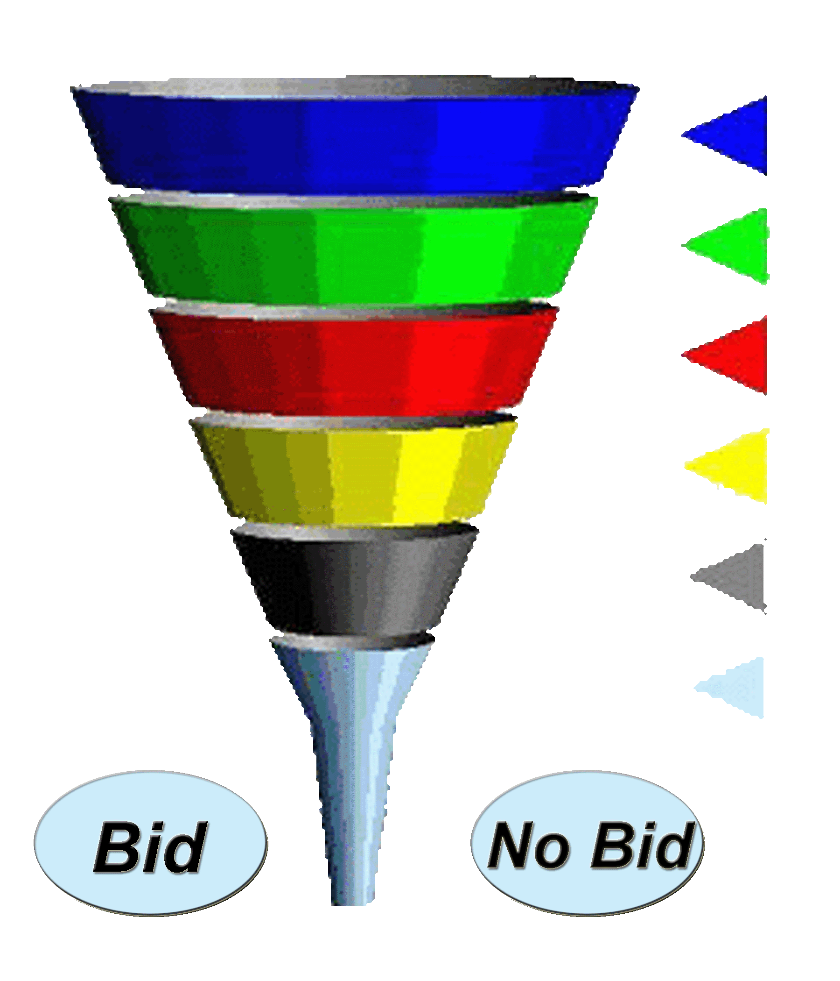
SAMPLE - Opportunity Funnel
Initial Evaluation
Core Business
Cost Benefit Analysis Filter
Feasibility/Availability/Funding
Q & A period
“Teams” Input

Slide 14
The Process Of Submitting Bids
Outline Bid – step 2
  Get all the “facts” – understand what the buyer really wants
  Select possible solutions to meet the RFP requirements
  Determine what resources, time, and capital will be required to submit a bid

Slide 15

Fact Finding Techniques
How can the vendor get the information they need to write a winning bid
  The Official Question and Answer Period
  The Vendors’ Conference
          No report can completely identify the atmosphere and unspoken clues you can get by attending

Slide 16
Fact Finding Techniques
Limited communication during official RFP process
Not always possible to ask questions in confidence
Questions can result in amendments to the RFP
Questions & Answers are distributed to all bidders
Protect proprietary or confidential information

Slide 17
Fact Finding Techniques
Strategies For Developing Effective RFP Questions
  Questions that identify statements or requirements that may be incorrect and require clarification - technical feasibility, professional expertise, terminology
  Questions that clarify your interpretation of the RFP
  Questions that will lead to a revision of the RFP

Slide 18
Fact Finding Techniques
Understand the buyers evaluation process
  Begins before RFP is even released
  RFP often sent to a select list of potential vendors
  Understanding the process from the buyer’s point of view is critical to positioning your product or service for a successful proposal

Slide 19
Fact Finding Techniques
The Most Important Information
  What does the buyer really need?
  What is their “CORE NEED”?

Slide 20
Fact Finding Techniques
Questions To Uncover The Buyer’s Core Need
  What is the result the buyer is hoping to achieve?
    Reduce costs / New business / Market Penetration Market Share / Counter Competitor’s Activities
  How does this RFP fit the buyer’s business vision?
  What is the most prevalent problem or pain?
  What are the most common problems experienced by similar organizations?

Slide 21
Fact Finding Techniques – Tips & Tricks
Build and leverage relationships
Be comfortable with all conversations
Ask the “Columbo” questions

Slide 22
The Process Of Submitting Bids
Select Your “Team” – step 3
  Creative Thinkers - for finding possible solutions and creatively solve potential problems
  Detail Thinkers - for planning the implementation
  Big Picture Thinkers - for project management

Slide 23
The Process Of Submitting Bids
Secure Resources – step 4
Work Assignments – step 5
Solutions – step 6
  Standard Solutions (Off The Rack)
  Custom Solutions (Tailored)
Proposal Review – step 7
Proposal Submission – step 8

Slide 24
Strategies for Successful Proposal Writing
Winning Strategy Is Not An Accident!
The ancient Chinese tactician Sun Tzu in The Art Of War tells us:
A good general has won the battle before it ever begins, positioning himself for victory before ever engaging the enemy.

Slide 25
What Do Buyers Really Look For When Choosing A Vendor?
TRUST
  Can they trust your firm to deliver on your promises?
CREDIBILITY
  Are your claims believable?
RELATIONSHIP
  How easy is your firm to work with?
  Will there be problems?

Slide 26
What all Proposals Require
Complete understanding of buyers need(s)
Appropriate / unique solution
Cost structure that provides value
Proves you are trustworthy, credible and an expert.

Slide 27

The Proposal Document
Process Design and Automation
  Keep it simple
  Create templates to eliminate repetitive work
  Ensure a consistent style

Slide 28
The Proposal Document
Format
  A clear, easy to read, well defined format is vital to communicate your message and win the contract
  Executive Summary:
      One to two pages maximum
      Summarize and communicate key points
      Intrigue the reader to read further

Slide 29
The Proposal Document
Format
  Table of Contents
      Help the reader find the key information quickly
      Few proposals will be read from beginning to end
      Be sure to include specific reference to any mandatory information requested in the RFP

Slide 30
The Proposal Document
Format
  Introduction
      Keep it short and relevant
      Outline goals and objectives clearly
      Reference key benefits and success factors

Slide 31
The Proposal Document
Format
  Sections and subsections
      Include all information requested in the RFP
      DO NOT ASSUME
      Be consistent with the RFP in naming the sections
      Expand on information considered critical to the success of the project

Slide 32
The Proposal Document
Format
  Consistent Themes
      Not everyone will read the proposal from front to back
      Capture key points in different sections to reinforce
      Keep the message consistent

Slide 33
Consistent Themes - examples
Management
  On-time – On budget
  Exclusive Expertise
Pricing
  Competitive Price
  Longest Life Cycle
Technical
  Advanced Technology
  Ease of Installation

Slide 34


The Proposal Document
Conclusion
  Keep it short
  Repeat key points and sign off
Following Directions
  Read and follow directions carefully
  Failing to follow directions could cost you the contract
&

Slide 35
Post Submission – Now What
We won ☺
  Congratulations – Now how do you deliver?
  We lost ☹
  Debrief with the issuer
      Continue to build the relationship for future contracts
      Be gracious and make your enthusiasm known
      This is THE key learning opportunity

Slide 36
Thank You
Any questions?

